Slide 1
Task 11 - Forces and Vehicle Safety
By parwana Gholami

Slide 2
PRINCIPLE A – CRUMPLE ZONES
Cars are made to crumple upon hit, lengthening the crash and lessening the force of impact. They are therefore not able to be very durable. This lowers the impulse, which is determined by the formula I=f x t. car crumple zones are places on a car that are made to crush in an accident in a controlled way. They lengthen the amount of time needed for the driver and passengers to alter their momentum in a collision, which lessens the force involved.

Slide 3
PRINCIPLE B – CRUMPLE ZONES
Crumple zones around those components enable the less rigid materials to withstand the first hit. As soon as the crumple zone begins to crumple, the car starts to slow down, adding a few extra tenths of a second to the deceleration.
Additionally, crumple zones aid in redistributing the impact's force. The intention is to direct the force away from the people because it must all go somewhere. Consider the force used in a crash as having a budget.
It's true that these racing cars with minimal ground clearance perform incredibly effectively because of their rapid responses to steering directions. Additionally, because they can drive, low-clearance cars are safer because they grip the ground.
Ground clearance includes the centre of gravity, which controls how far the wheels of the vehicle may travel. A vehicle with low ground clearance seems to be more reliable at maintaining a low driving position than a car with greater rigidity, which makes it less likely to tumble or roll over during sudden turns.

Slide 4
PRINCIPLE C - AIRBAGS
The airbag slows down the driver or passenger more gradually as their head and torso are pushed inside the airbag. Airbags diffuse the force of the collision over a wider contact area, which further lessens the force by lengthening the time factor. By doing this, the pressure on your body is lessened because the force is not entirely concentrated in a single, restricted location. Your injuries' severity will consequently be lessened as a result of this.
When in a vehicle accident, wearing a seat belt lengthens the occupant's stopping distance. This decreases the force of impact that is applied to the occupant, in accordance with the work-energy concept. The driver's speed and direction are stopped by the seatbelt's uneven force. Because all moving objects contain energy, seat belts are made to stop when there is a take that energy away from you.
The point of airbags is to stop the people from hitting their bodies against the insides of the vehicle, which is like what seatbelts do when they keep the people in their seats. In a crash you could hit your head on the dashboard or on the side window glass and hurt yourself.

Slide 5
PRINCIPLE D – SEAT BELTS
All vehicle accidents, no matter how serious or little can be prevented primarily by wearing a seat belt. As seen in the modern seatbelts are anchored utilising a three-point method, with two points coming across the body to connect to the ceiling and one point on either side of the seat.
The mass of your body is connected to the mass of the vehicle by a seat belt, so you move with the vehicle's acceleration and deceleration. Without seatbelts, Newton's First Law would affect your body. The passenger would continue to move at constant speed if the vehicle suddenly stopped (for example, in a car accident) and they weren't wearing seatbelts. This would likely result in a collision with the windscreen or the back of the seat in front of them.

Slide 6
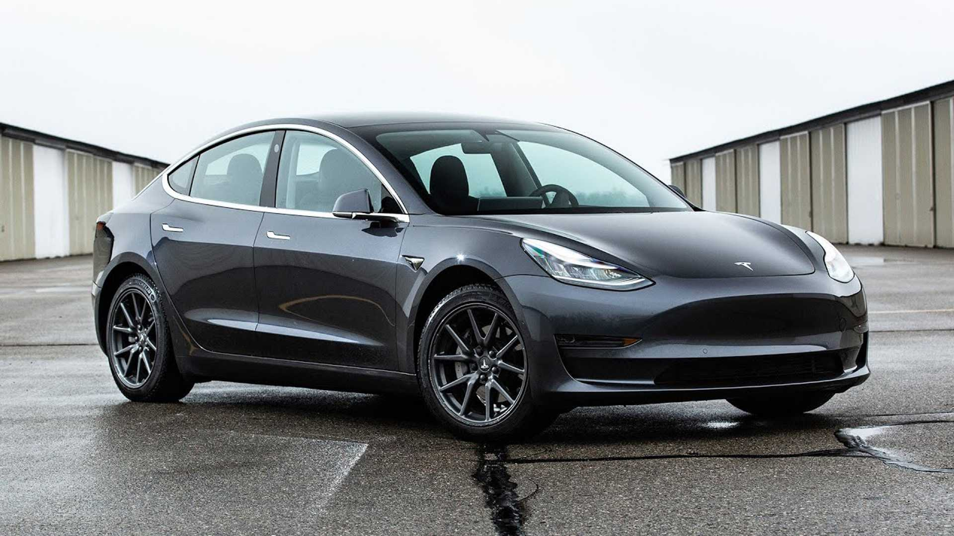
CHOSEN VEHICLE: TESLA MODEL 3
Tesla vehicles are created with the highest safety standards in mind, from their design and physical construction to their security.
Tesla provides a variety of improved security mechanisms that are simple to activate. For example, the Cabin Camera is When Autopilot is activated, the cabin camera can identify driver inattention and issue you with audible alerts to prompt you to maintain eye contact with the road.
Tesla cars have their batteries along the base of the car so a lot of their weight is here, which means if the car is involved in a crash and rolls, it will usually land the right way up which protects the passengers.
Security Alarm may also force the headlights of the vehicle to flash, may send a page to the owner of the vehicle informing them of the incident, and may stop one or more electrical circuits required for the car to start. Sentry Mode When parked and locked in certain locations, a Tesla vehicle can monitor suspicious activity using the anti-theft feature known as Sentry Mode. For instance, if a serious threat is identified, your car's cameras will start to record and the alarm system will activate.

Slide 7
Classify the principles to each safety feature explained
PRINCIPLE A --- Increasing the time of the collision or the time the occupants take to stop
Car crumple zones are places on a car that are made to crush in an accident in a controlled way. They lengthen the amount of time needed for the driver and passengers to alter their momentum in a collision, which lessens the force involved.
PRINCIPLE B --- Spreading the forces of impact over the largest possible area & ensuring the stability of the vehicle.
Crumple zones around those components enable the less rigid materials to withstand the first hit. As soon as the crumple zone begins to crumple, the car starts to slow down, adding a few extra tenths of a second to the deceleration.

Slide 8
Classify the principles to each safety feature explained
PRINCIPLE C --- Minimizing contact of the person with the interior of the vehicle
AIRBAGS - For the driver and passengers' protection, the airbag system must activate just milliseconds after a collision to ensure its effectiveness. The point of airbags is to stop people from hitting their bodies against the insides of the vehicle.
PRINCIPLE D --- Keeping the person inside the vehicle
SEATBELTS - help the occupant to decelerate at the same rate as the vehicle in a crash and stops them from being thrown out of the car if there is a crash or it stops suddenly.

Slide 9
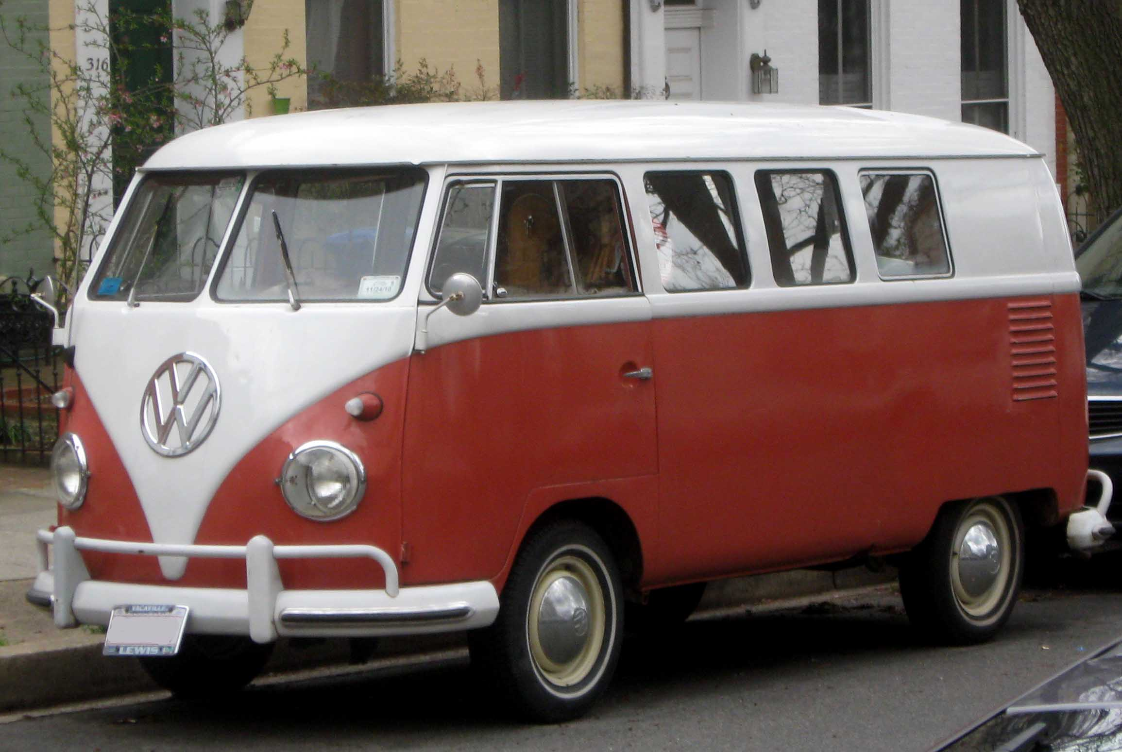
VW Kombi van (pre-1960) - describe the features that make it unsafe
There are no airbags to protect the occupants if there is a crash.
The seats were very basic bench seats with not much back or neck support.
Seatbelts would not have been included and could be dangerous to the occupants if you crashed.
There is no crumple zone because the front is flat and would impact the driver in a crash.

Slide 10
Classify the principles to each unsafety feature explained
PRINCIPLE A --- Increasing the time of the collision or the time the occupants take to stop
The majority of the energy and actual collision damage will be absorbed by a vehicle colliding with a solid car without a crumple zone.
PRINCIPLE B --- Spreading the forces of impact over the largest possible area & ensuring the stability of the vehicle.
This model had a high centre of mass, which reduced the vehicle's stability because a lower centre of mass increases stability.

Slide 11
Classify the principles to each unsafety feature explained
PRINCIPLE C --- Minimizing contact of the person with the interior of the vehicle
- Because this particular kind of vehicle lacked airbags, anyone who is driving would not be safe in the event of a collision.
PRINCIPLE D --- Keeping the person inside the vehicle
This model lacked seat belts, which means that if a collision occurs, the occupant will keep moving into the windscreen. Because of Newton's first law of motion, this will happen (inertia)

Slide 12
Summarise the role of safety in a car design
To address the safety issues presented by various contexts, car design is continually changing. There have been numerous new safety-focused features added to cars, especially in the previous forty years, which have significantly decreased the number of fatalities and serious injuries resulting from auto accidents.

Slide 13

Suggest improvements using principles of physics
add more airbags which in other circumstances may aid in preventing injury. Although front air bags are useless in rollovers, side hits, and other sorts of collisions, many contemporary vehicles come equipped with air bags deployed in other places.
durable seatbelts
When a car suddenly stops or crashes, seat belts support the body and save the occupants from being flung from the vehicle. Because the force is distributed to the body's strongest portions, the chest and pelvis, using a seat belt lessens the likelihood of injury.
Install a reversing camera

